Slide 1
CSE 4128
LAB TEST: Section A
Dr. Sk. Md. Masudul Ahsan
Professor,
Dept. of Computer Science and Engineering,
KUET
Md Tajmilur Rahman
Lecturer,
Dept. of Computer Science and Engineering,
KUET

Slide 2
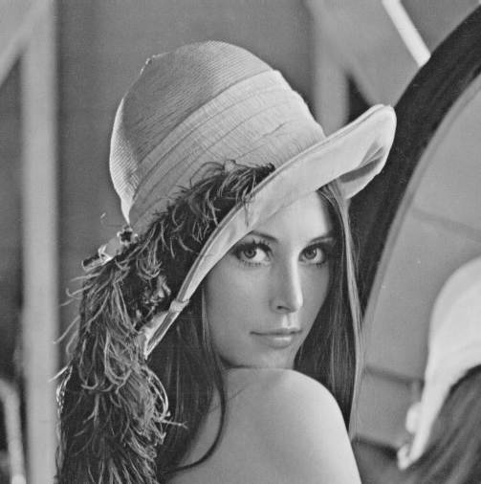
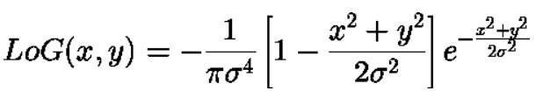
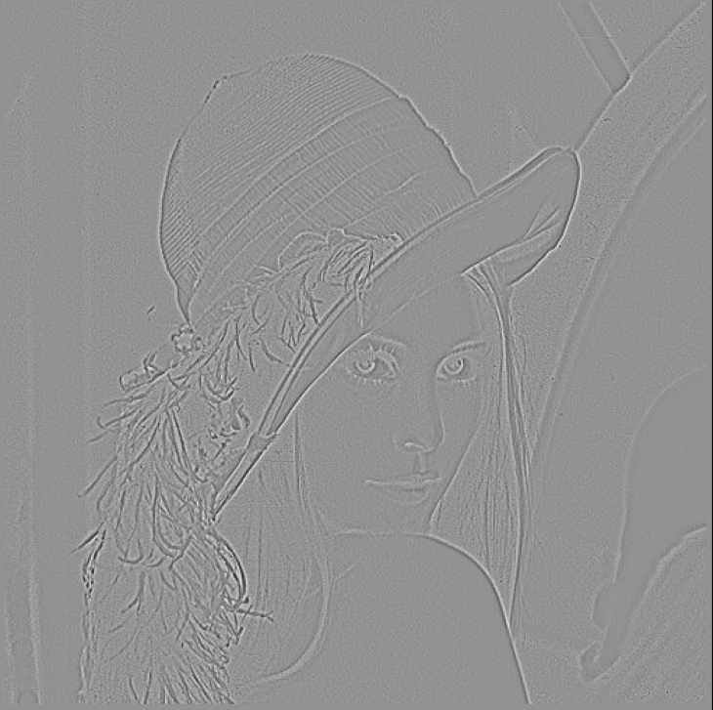
Problem 1
Convolve the Lena image using Laplacian of Gaussian kernel.
Generate kernel using Laplacian of Gaussian with user-defined kernel size and sigma.
Use the kernel to apply convolution on the following input image.
N.B.: You can use the library function for convolution. Use Sigma = 1, kernel size= 7X7 to match output
Input
Output
Sigma = 1,
kernel size= 7X7

Slide 3
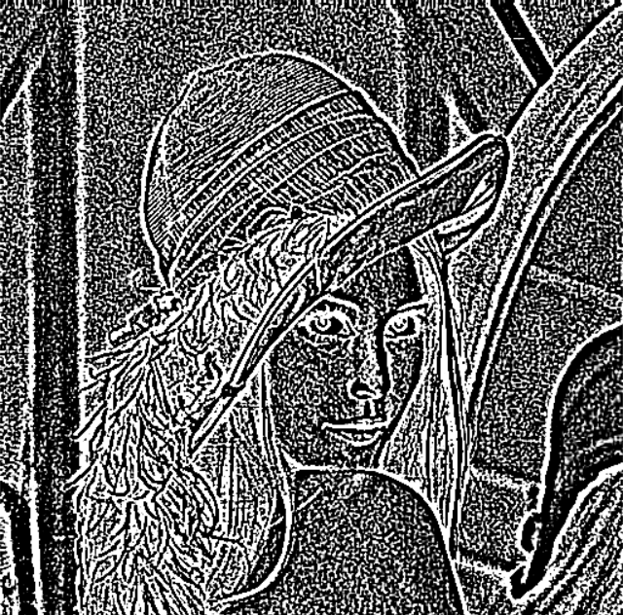
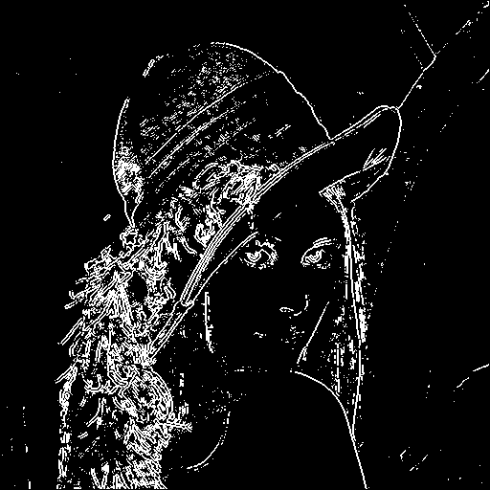
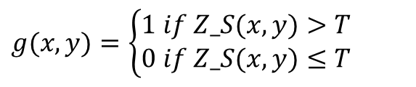
Problem 2
Input = cv2.imread(‘LoG.tiff’, cv2.IMREAD_UNCHANGED)
Detect the edges of the given derivative image by finding zero cross points and Global Thresholding.
Find the zero-cross points on the input.
Apply Global thresholding in the on the zero-cross strength (ZS) map. Where, Zero cross strength
ZS = ∑ |current_pixel – neighbor_pixel|
$$g(x,y)=\left\{\begin{matrix}1 if Z_S(x,y)>T \\ 0 if Z_S(x,y)≤T\end{matrix}\right.$$
Edge
point
zero
crossing?
yes
Input Image
ZS > T
Output
T = 12
No
No
not an
edge point
not an
edge point
N.B.: You can use any library functions

Slide 4
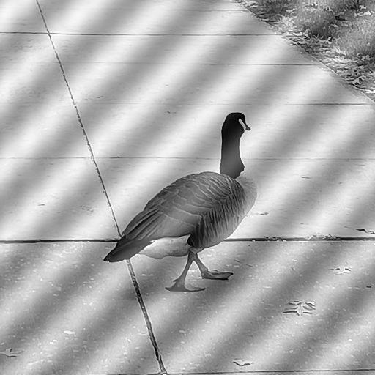
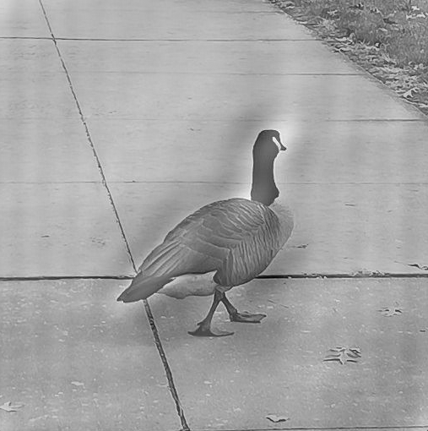
Problem 3
Apply the following Notch reject filters on the Fourier domain to remove periodic noise from the image.
Input
H(u,v) = 0, if D(u,v)<=D₀ and
1, if D(u,v)> D₀
As for the center, use the given input values center (X,Y)=(261, 261), and D_{o}=5
Output

Slide 5
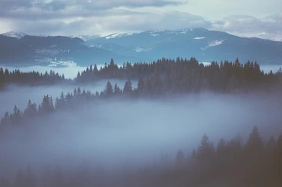
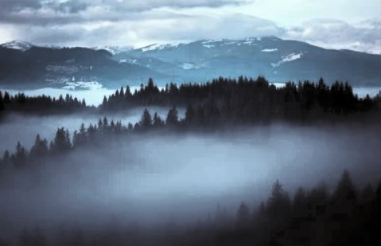
Problem 4
Stretch the image so that its histogram is equalized over the whole intensity.
Perform equalization in the intensity Value channel of the HSV model.
Show the output image in RGB mode with the histogram of the input image and the equalized image.
Plot the pdf and cdf for bot input and output images.
Input
Output

Slide 6
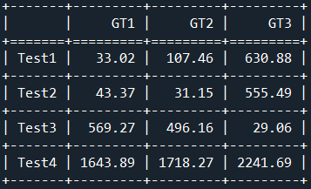


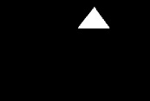




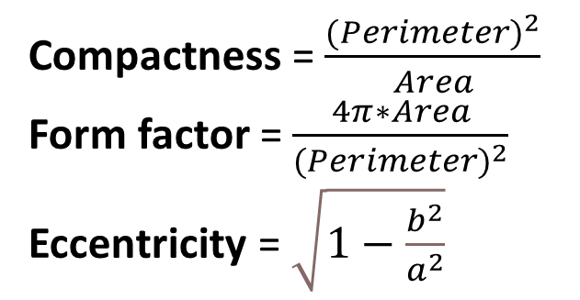
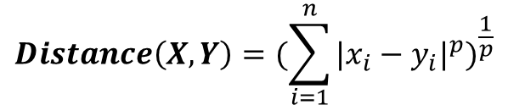
Problem 5
Calculate Form factor, Eccentricity, and Compactness for the given Binary images and calculate their similarity using given equation.
Compactness = $\frac{{(Perimeter)}^{2}}{Area}$
Form factor = $\frac{4π∗Area}{{(Perimeter)}^{2}}$
Eccentricity = $\sqrt{1−\frac{b^{2}}{a^{2}}}$
Where,
a = major axis length of the bounding ellipse
b = minor axis length of the bounding
$$Distance\left(X,Y\right)={(\sum_{i=1}^{n}{{|x_{i}−y_{i}|}^{p}})}^{\frac{1}{p}}$$
Here, X and Y are the descriptor vectors for 2 images, n=3 for Form factor, Eccentricity, and Compactness. Use p = 1 for the similarity measurement.

